Slide 1

Movie Recommendation - Chat Bot
Matt Castelli

Slide 2
Project Description
Problem
New users on a streaming platform might not know what is available or what they would be interested in (cold start)
Existing users might want recommendations because they are being indecisive
Solution
Use a chat bot to gather information from a user about their movie preferences and then recommend appropriate movies tailored to user interests

Slide 3
Project Design & Technology Stack
Data
IMDB Top 1000 Movies
Columns: Title, Certificate, Runtime, Genre, IMDB Rating, Overview, Actors, etc.
Models
Chat bot (Rule Based)
Recommendation System (Content Based)
Outcome
Tailored movie suggestions
Tech Stack
Recommendations system: sklearn or TensorFlow Recommenders
Chat bot: spaCy, ChatterBot, or NLTK

Slide 4
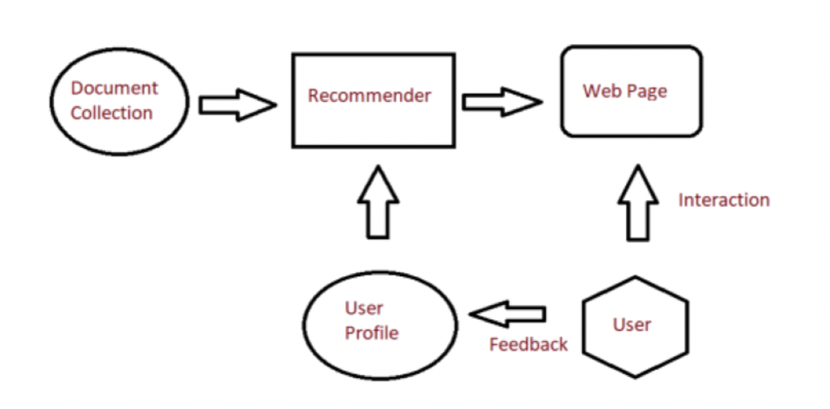
Content Based Recommendation System

Slide 5
Ethical Considerations
Not recommending inappropriate movies to the wrong audience
Not allowing for inappropriate interaction with the chat bot (questions / answers)
From Chat bot or users

